Slide 1
NICU - Common Legal Issues in Neonatal Nursing
Kathryn S.M. Mosely, Esq.
Leibl, Miretsky & Mosely, LLP

Slide 2
Litigation
Fundamental Error
Anger/Disappointment
Surprise/Distrust
Truthseeker:
What happened and why?

Slide 3
Elements of Medical Negligence
Duty of Care Owed to Patient
Standard of Care
Breach of Duty Owed
Causation
Damages
General
Special
Punitive

Slide 4
Duty of a Health Care Professional (CACI 501)
A [medical practitioner] is negligent if he/she fails to use the level of skill, knowledge, and care in diagnosis and treatment that other reasonably careful [medical practitioners] would use in same or similar circumstances. This level of skill, knowledge, and care is sometimes referred to as “the standard of care.”

Slide 5
Success Not Required (CACI 505)
The healthcare professional is not necessarily negligent just because their efforts are unsuccessful or they make an error that was reasonable under the circumstances.
Standard of care is not
Perfect Treatment
Absence of Mistakes
Bad Outcome

Slide 6
Alternative Methods of Care (CACI 506)
A medical practitioner is not necessarily negligent just because they chose one medically accepted method of treatment or diagnosis and it turns out that another medically accepted method would have been a better choice.

Slide 7
Purpose of the Medical Record
Reflects Judgment and Plan
Reflects Diagnostic Tests and Results
Communicates Plan

Slide 8
Documentation of Medical Records
The medical record facilitates:
The ability of the physician and other healthcare professionals to evaluate and plan the patient’s immediate treatment, and to monitor healthcare over time.
Communication and continuity of care among physicians and other healthcare professionals involved in the patient’s care.
Accurate and timely claims review and payment.
Appropriate utilization review and quality of care evaluations
Collection of data that may be useful for research and education.

Slide 9
Benefits of Documentation
Juries place great weight on what information is and is not included in the medical records.
The patient’s memory will fade but what is in the record does not.
The faintest ink is more powerful than the strongest memory.
Documentation prevents the opposing expert from making unwarranted assumptions about care.

Slide 10
Documentation of Medical Records – Overview
Particular emphasis must be placed on the factors that improve the quality and usefulness of charted information.
Accuracy
Relevance
Completeness
Timeliness

Slide 11
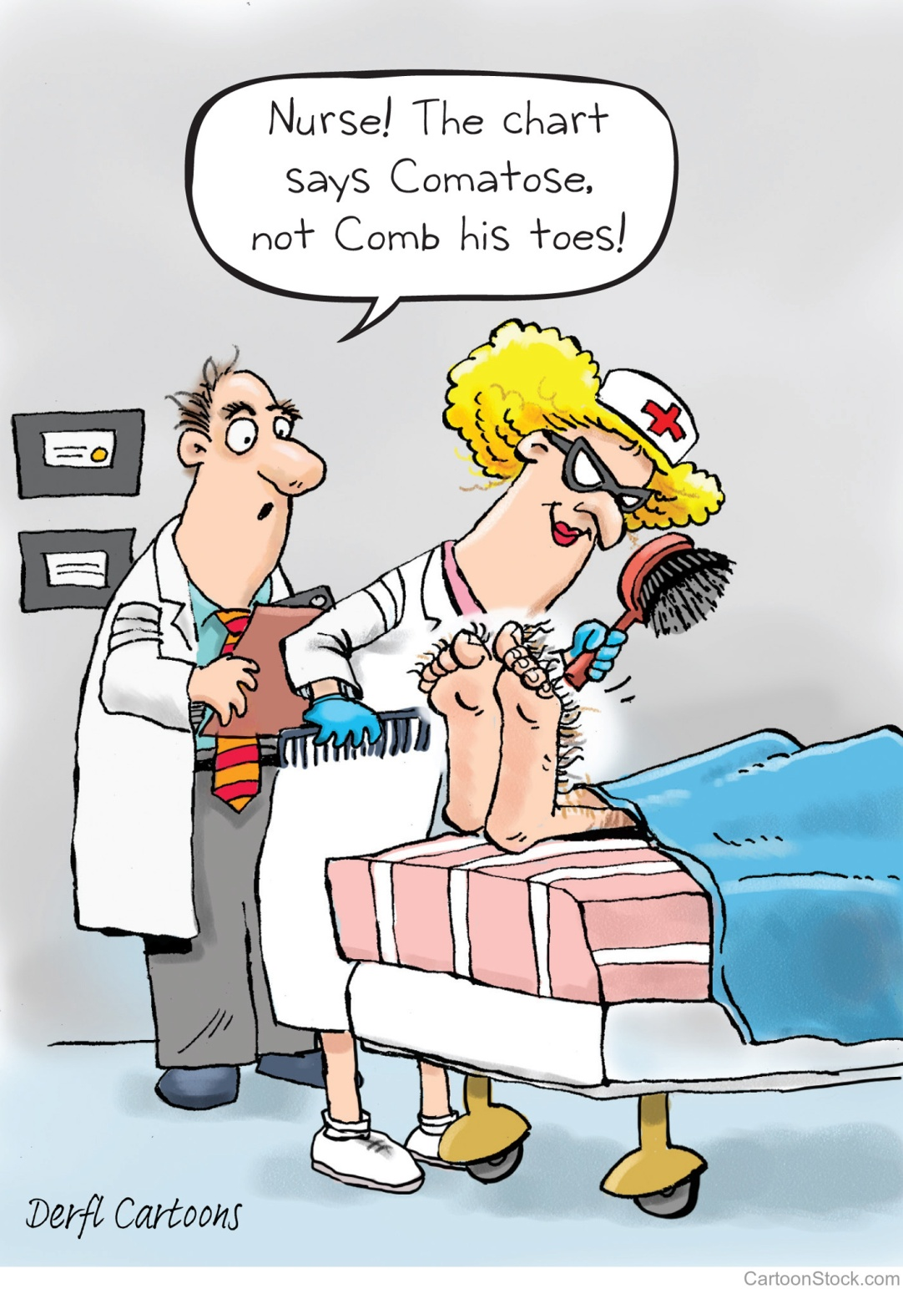

Slide 12
Documentation of Medical Records
Accuracy:
Each individual medical record must be correct.
Information in the medical record is relied upon for accuracy throughout the patient’s lifetime
Inaccuracies (either commission or omission) lead to improper medical advice being provided and may result in adverse healthcare outcomes.

Slide 13
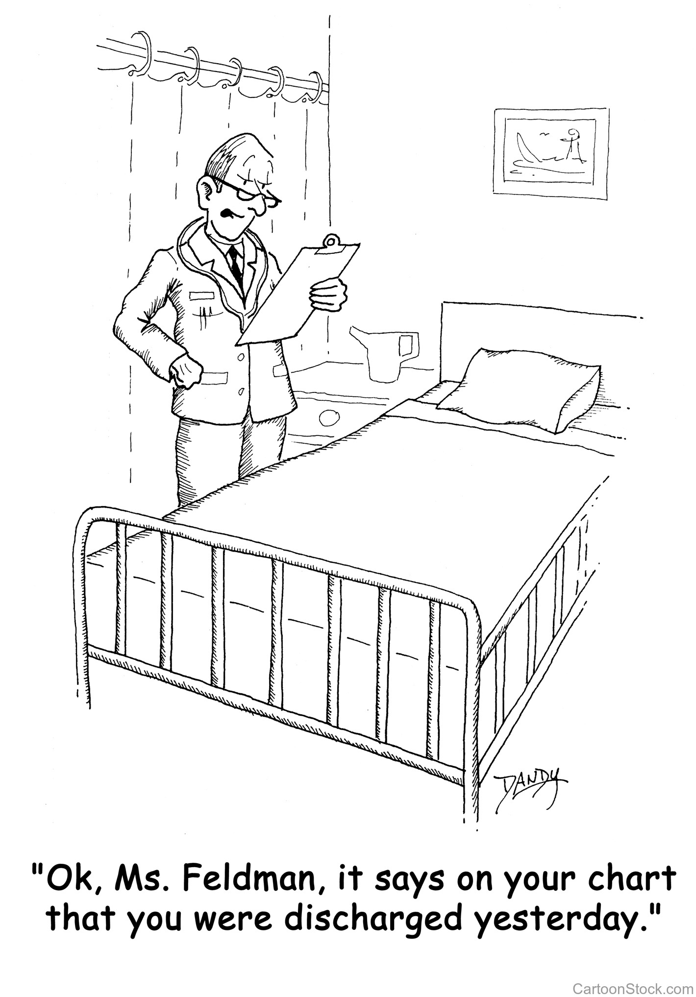

Slide 14
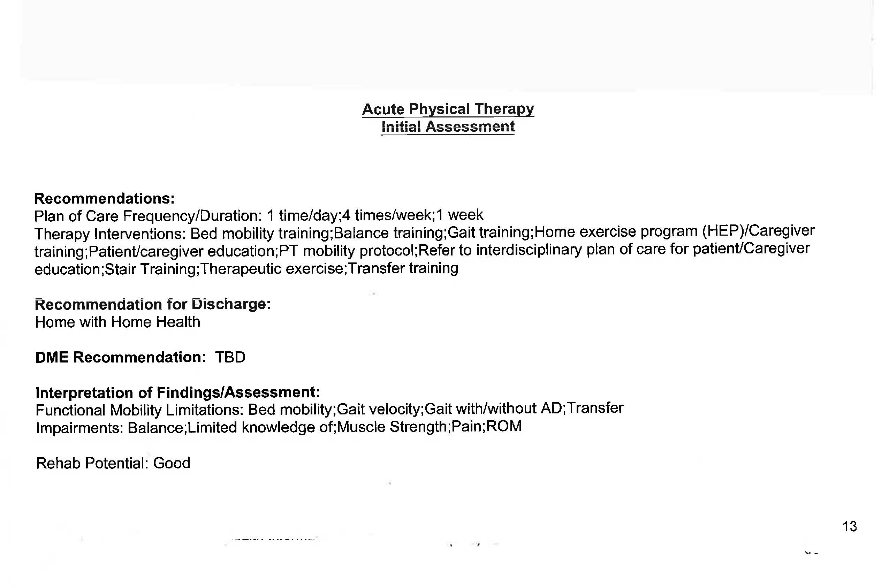

Slide 15
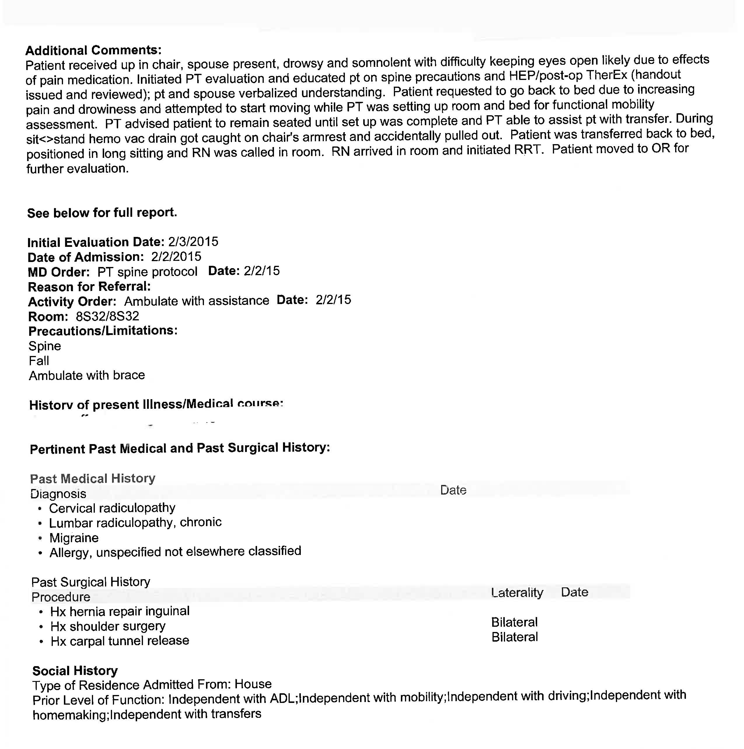

Slide 16
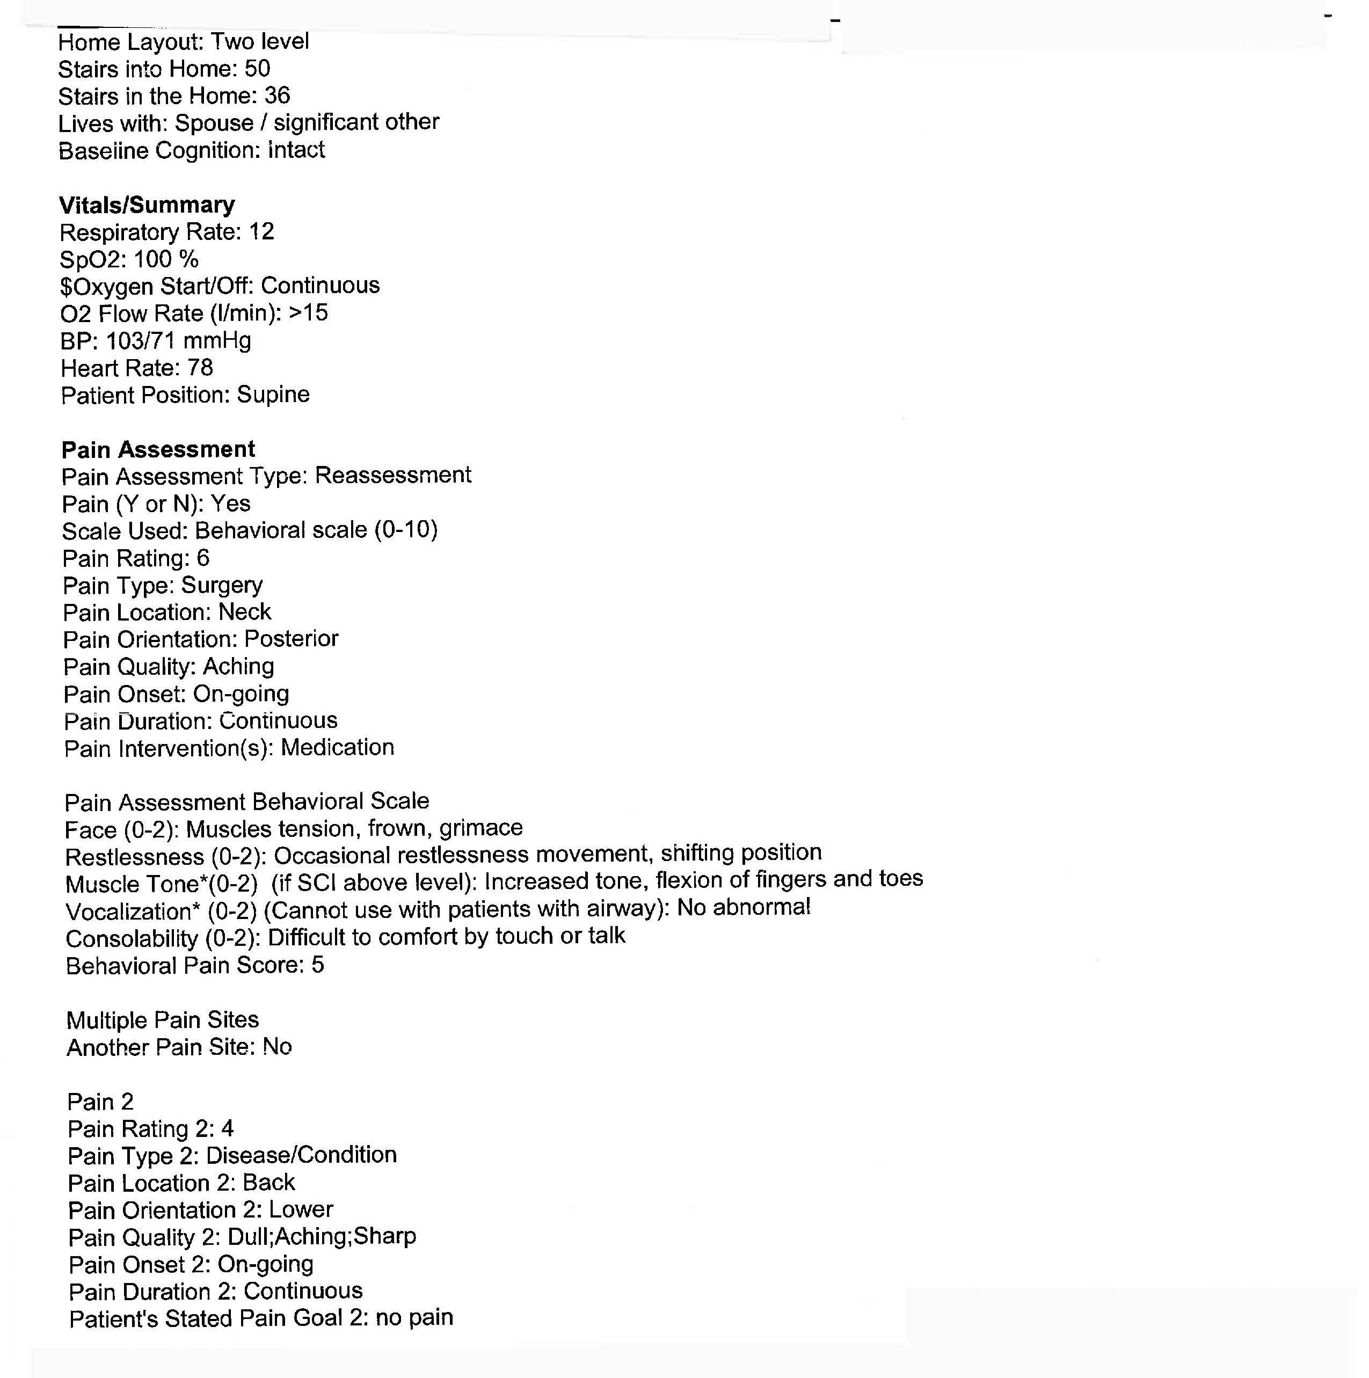

Slide 17
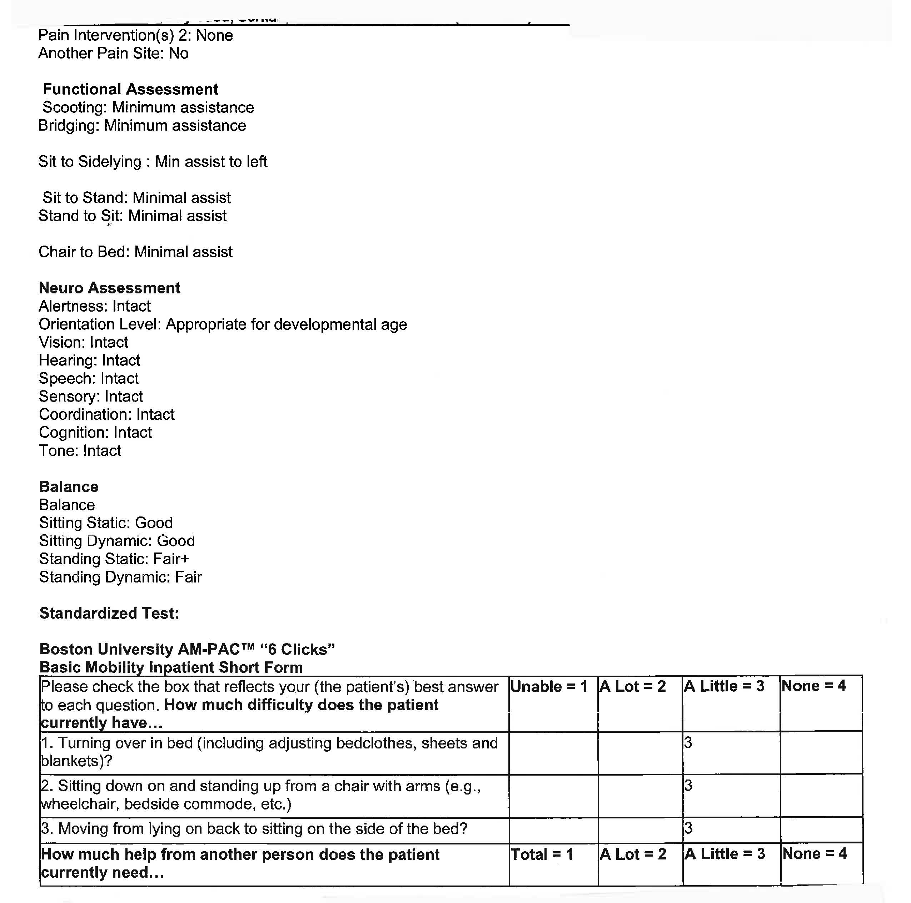

Slide 18
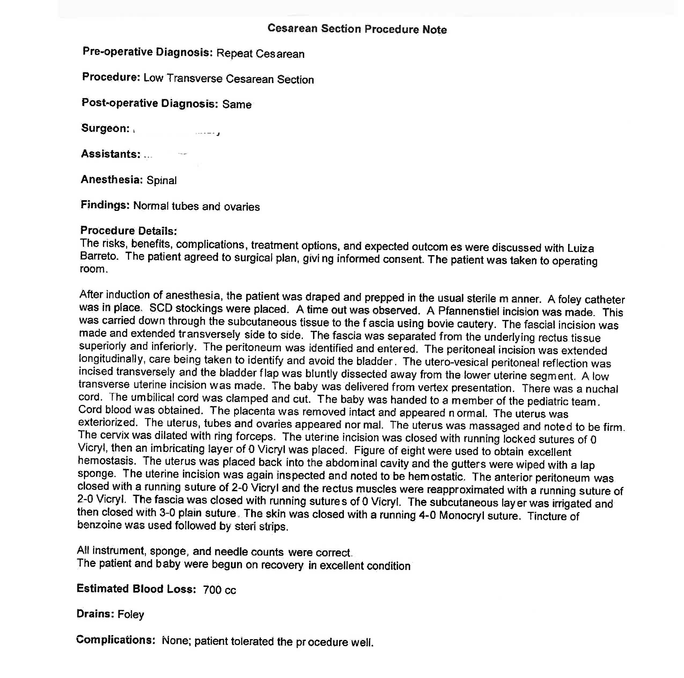

Slide 20
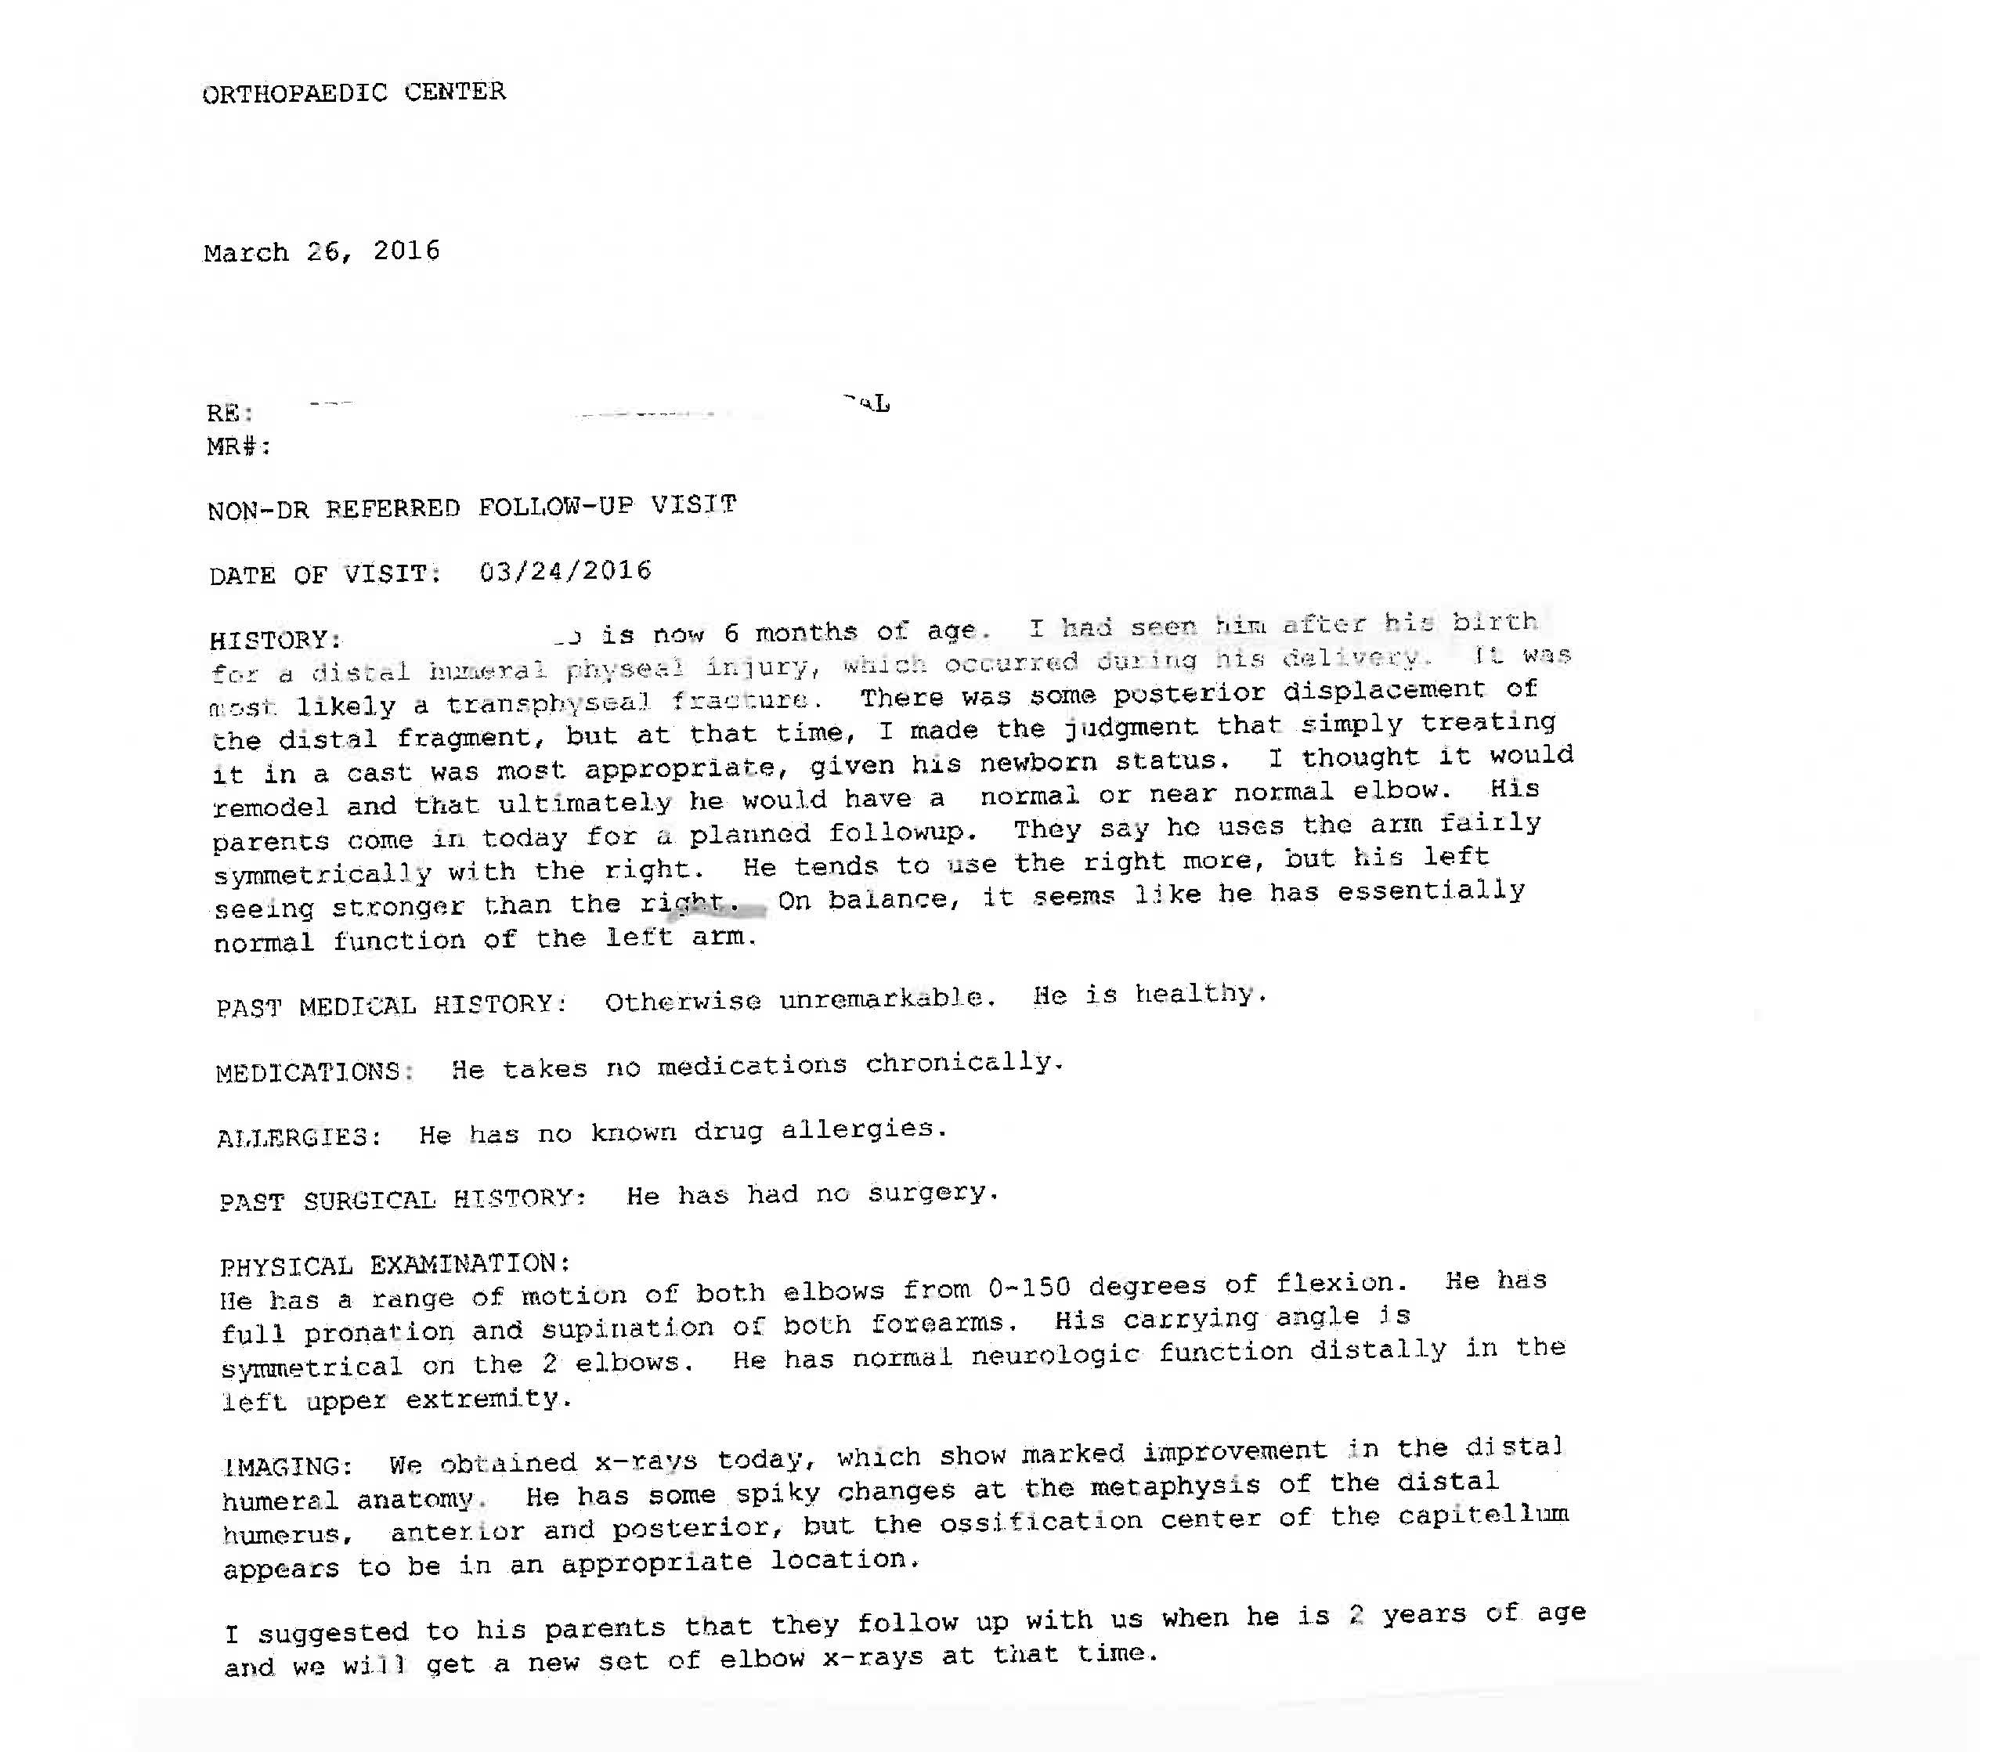

Slide 21
Documentation of Medical Records
Relevance:
Medical records contain only information relevant to the patient’s healthcare
Inclusion of inappropriate and irrelevant information results in potential action.

Slide 22
Clear/Concise/Consistent Charting
Timing
Entries should be contemporaneous to event
Delays in documenting can give impression of delays in treatment
No early entries
Narratives
Needed when there is change
Transfer to higher level
Physician contact

Slide 23
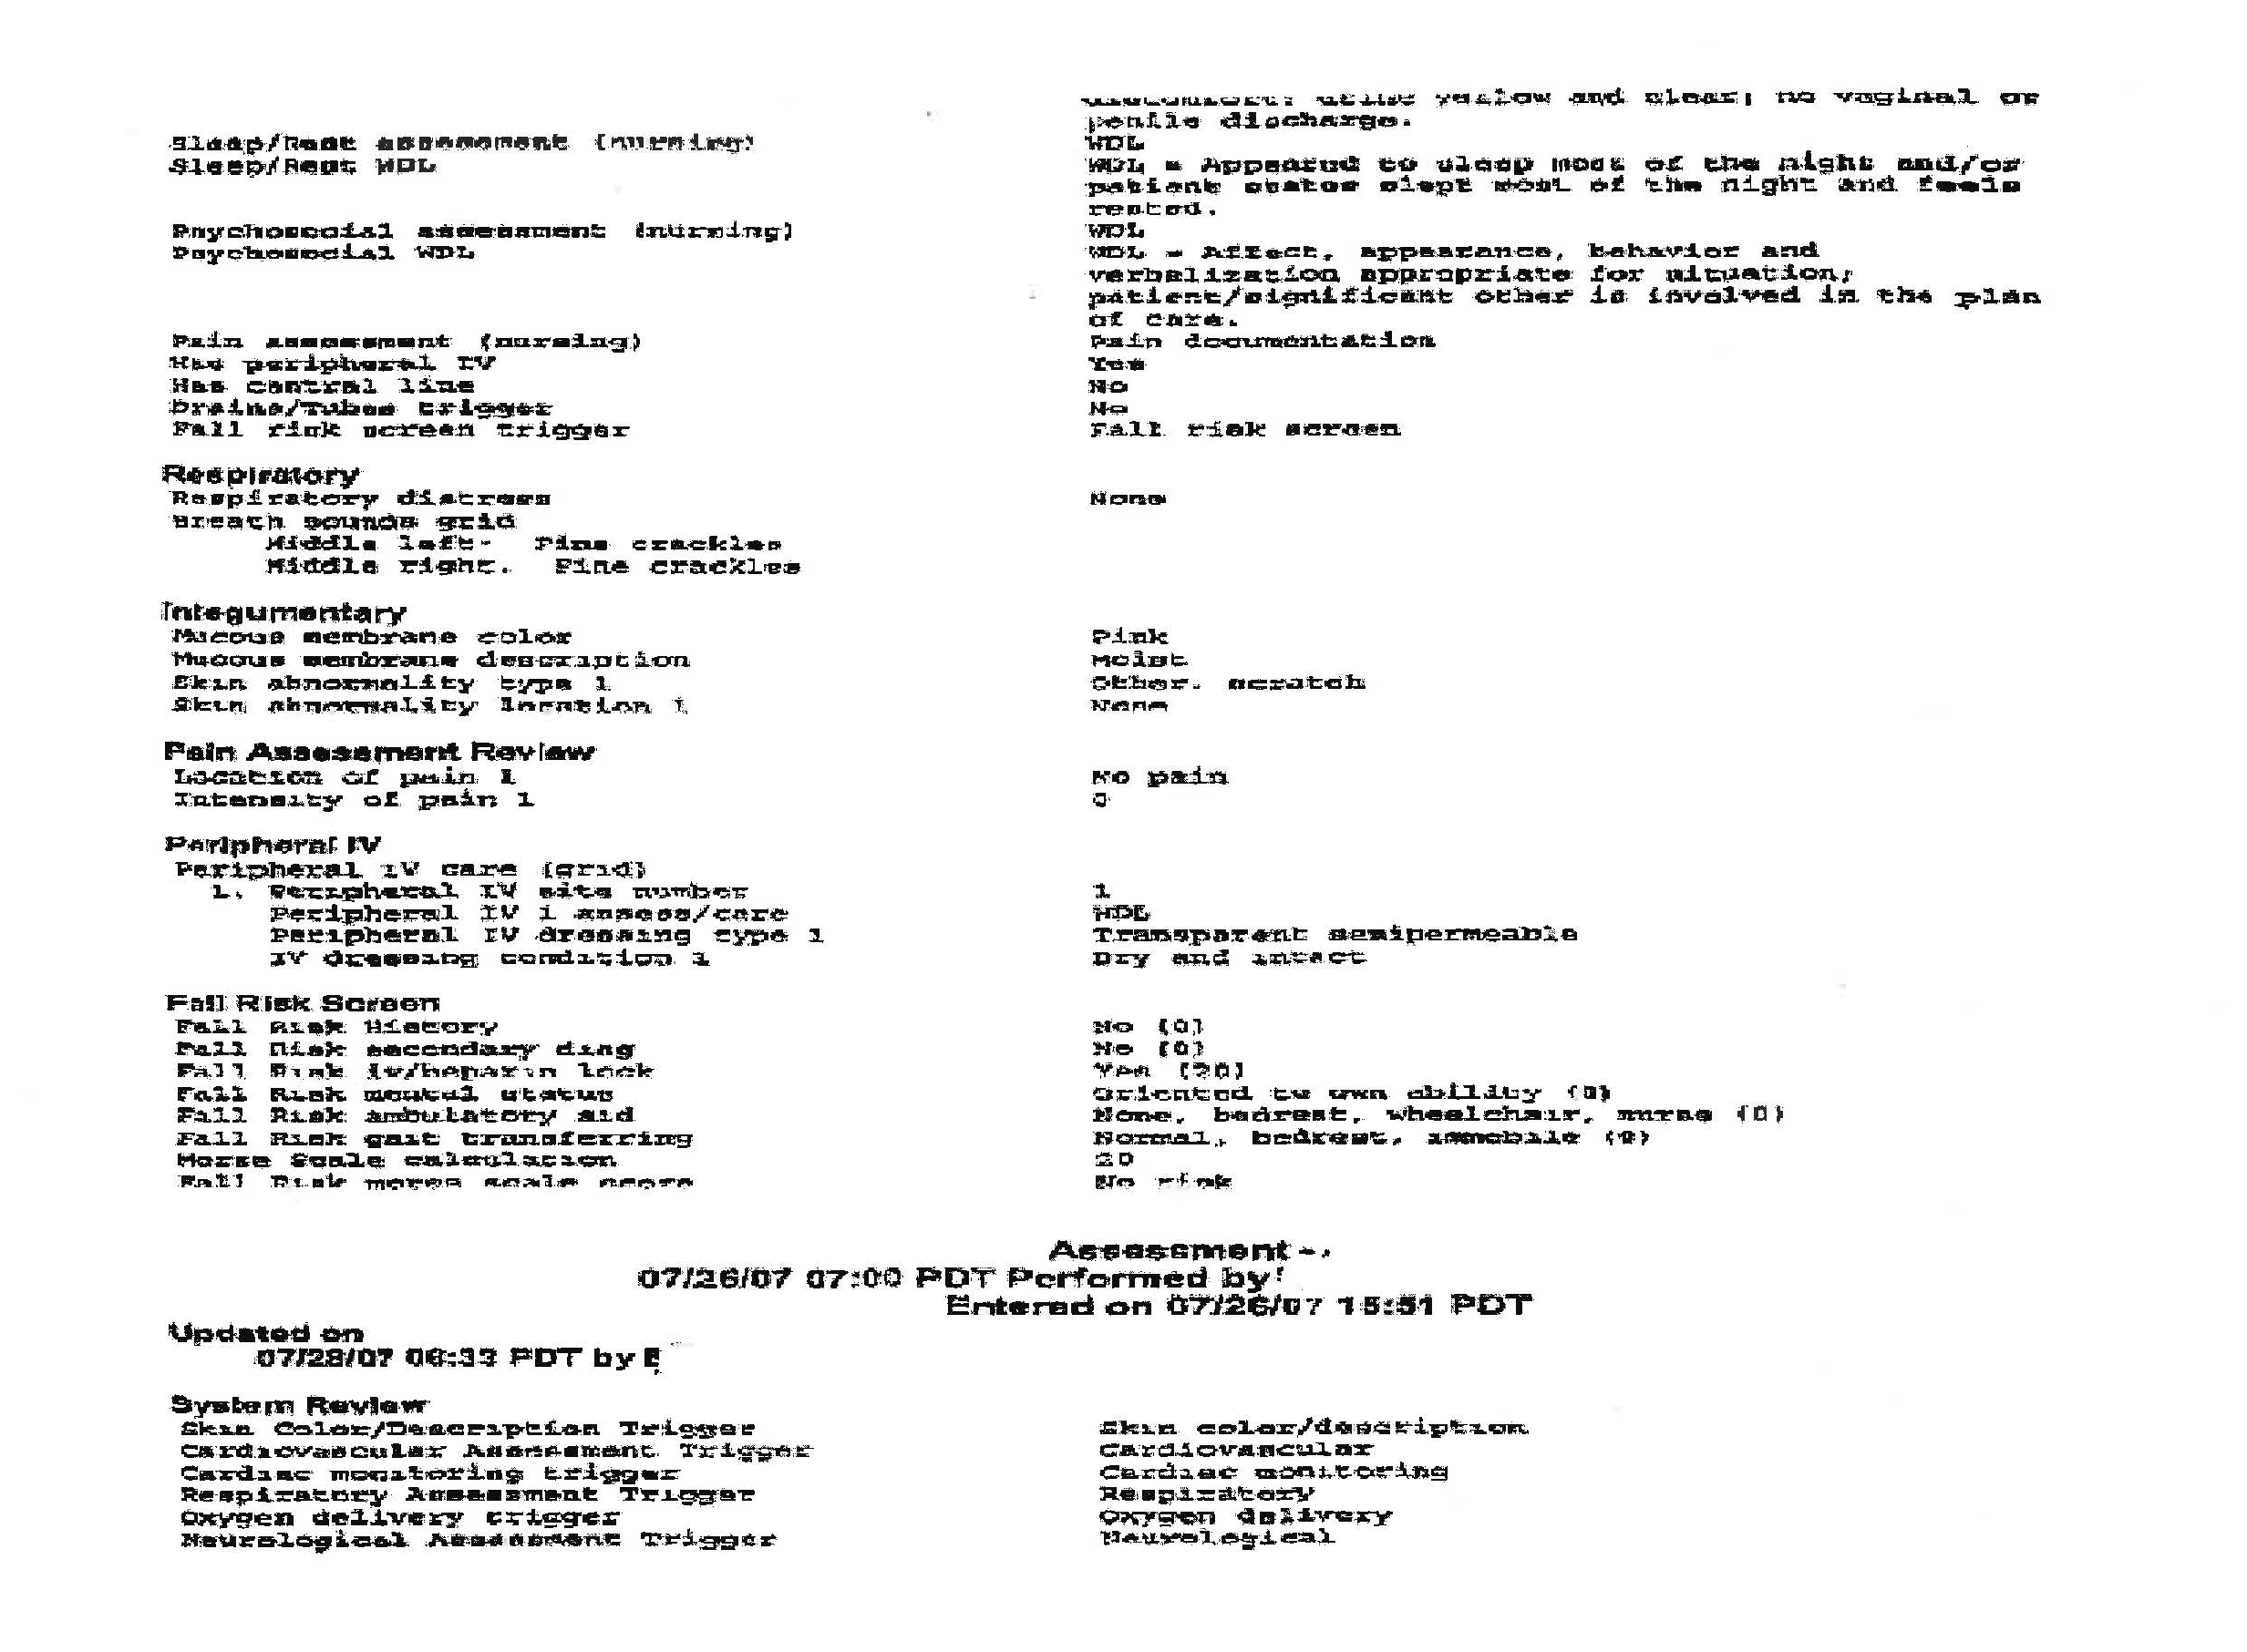

Slide 24
Good, Bad, & Defensive
Factual Information
Objective
Adverbs/adjectives
What does the patient look like?/What is the response?
Use cohesive thoughts
Use proper grammar
Proper spelling

Slide 25
Do’s
No general statements
“Patient Reassured”
Chart Patient’s Understanding
Discussion with Parents/Patients
Codes
Use Specific Symptoms

Slide 26
Do’s
Use acceptable terminology and abbreviations
Read the notes of other professionals, respond to questions
Chart initial assessment, plan of care, follow-up results
Chart on non-compliant patient for refusing treatment/procedure

Slide 27
Further Keys to Charting
Justification for treatment when choices exist
Follow-up activities
Teaching & instructions (understanding of)
Translators utilized

Slide 28
Computer Charting
Stock phrases are repeated
Drop down menus are used and narratives are forgotten
When the chart is reproduced on paper, it does not look like the version on the computer screen
Printouts show: Time entry made; by whom; when accessed and identifies when changes were made
Everything is discoverable
No “back screens”
No private notes

Slide 29
Remember
Medical Record is all the remains after a healthcare memory fades away.
Drop down menus and narratives
Do the pre-determined selections fit?
Don’t get tied to the computer

Slide 30
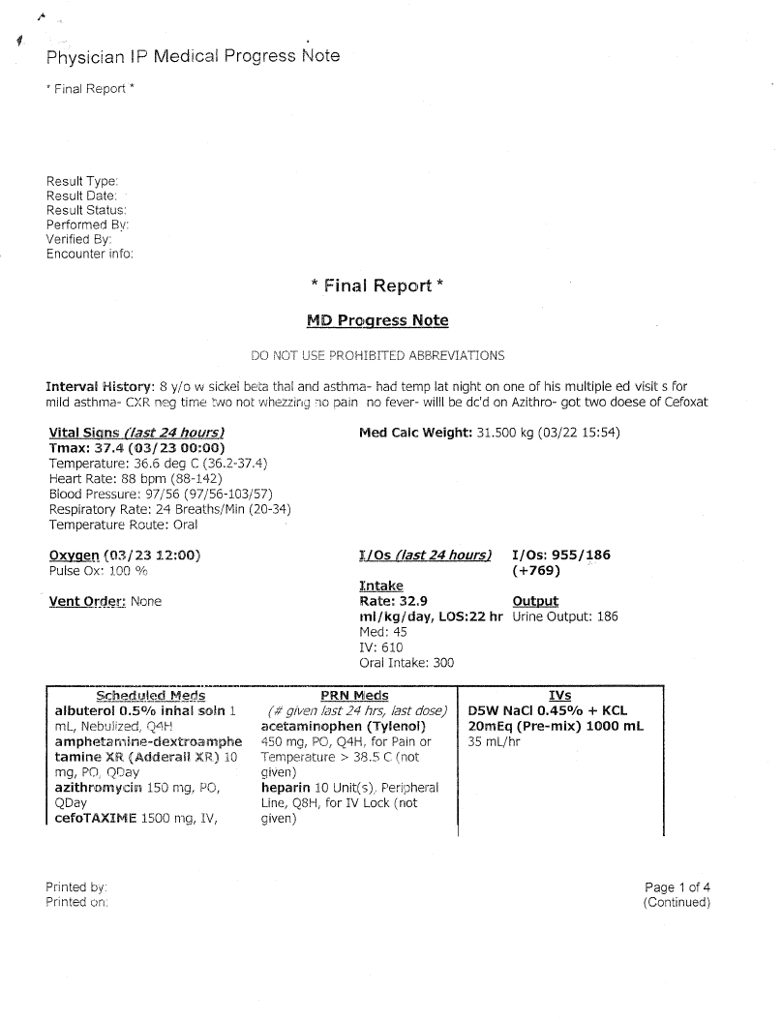

Slide 32
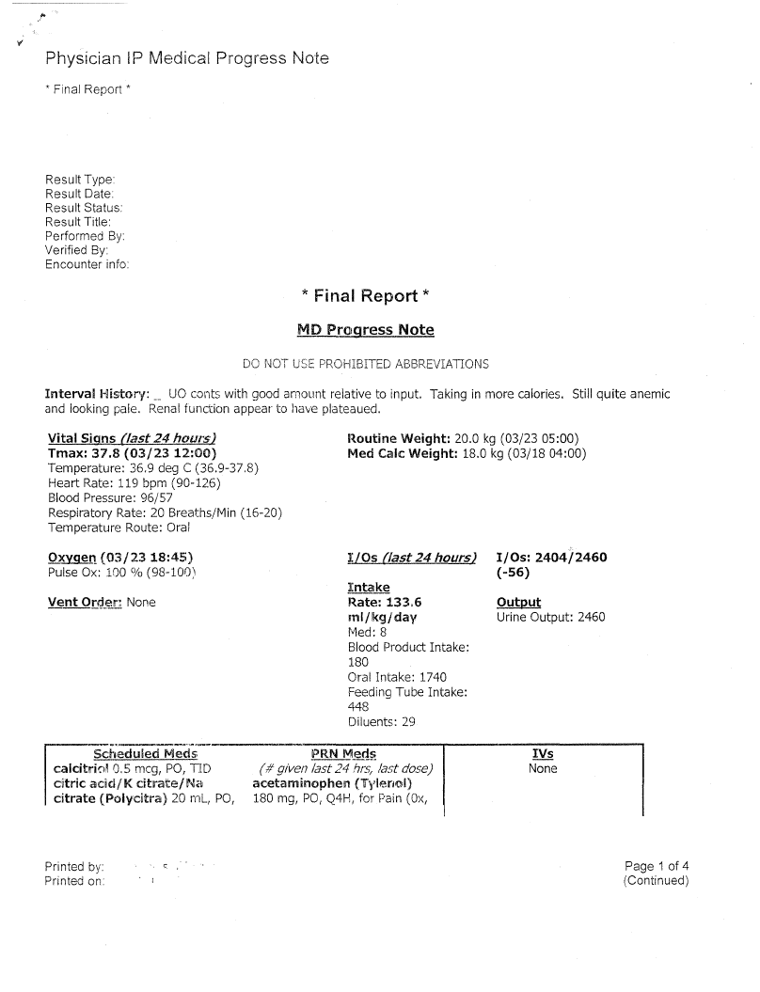

Slide 33
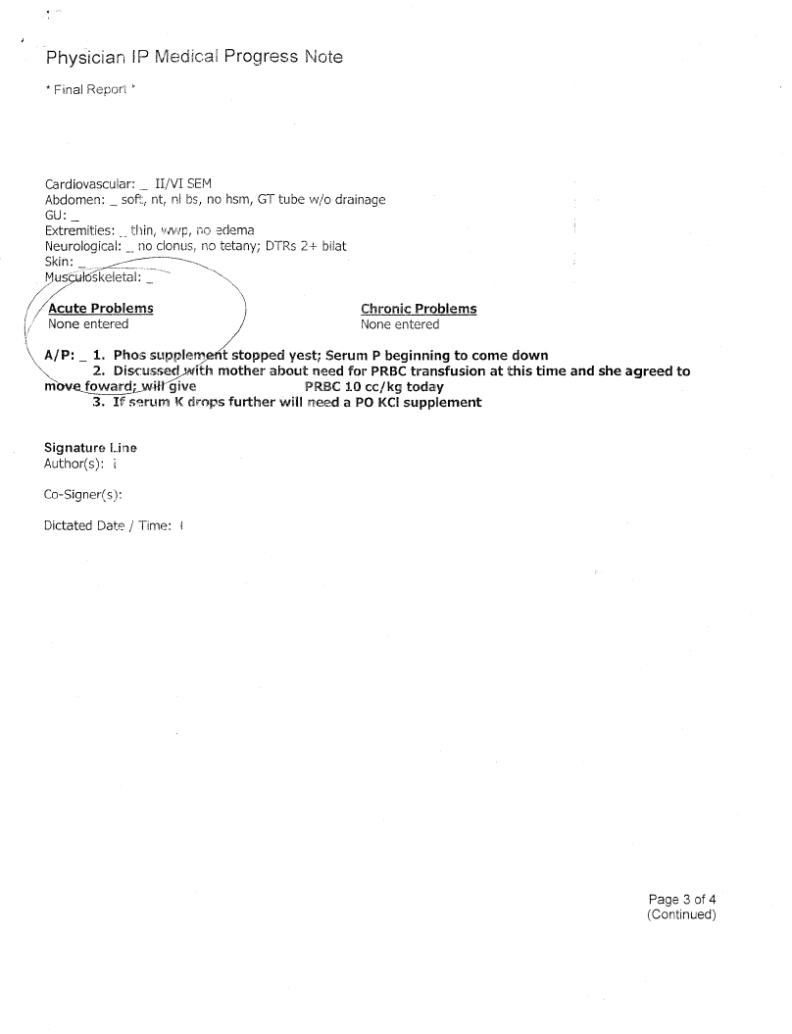

Slide 34
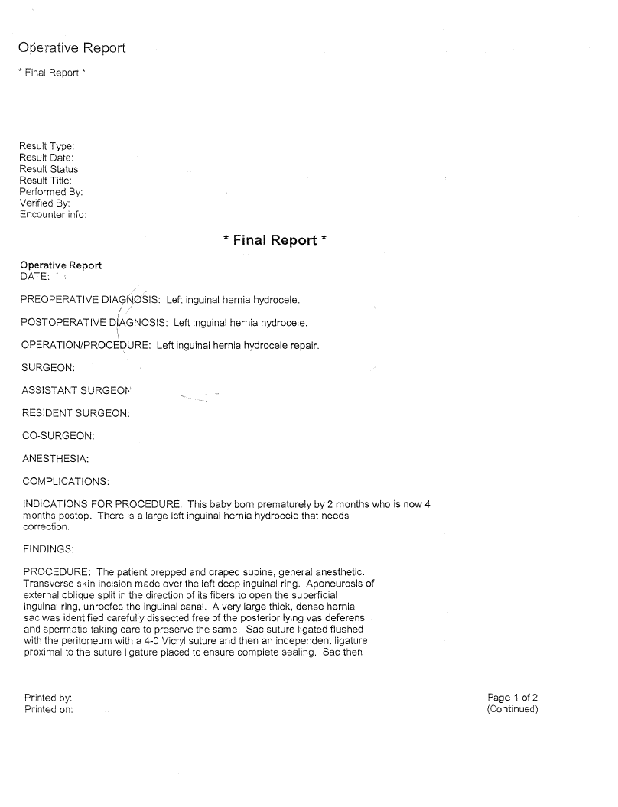

Slide 35
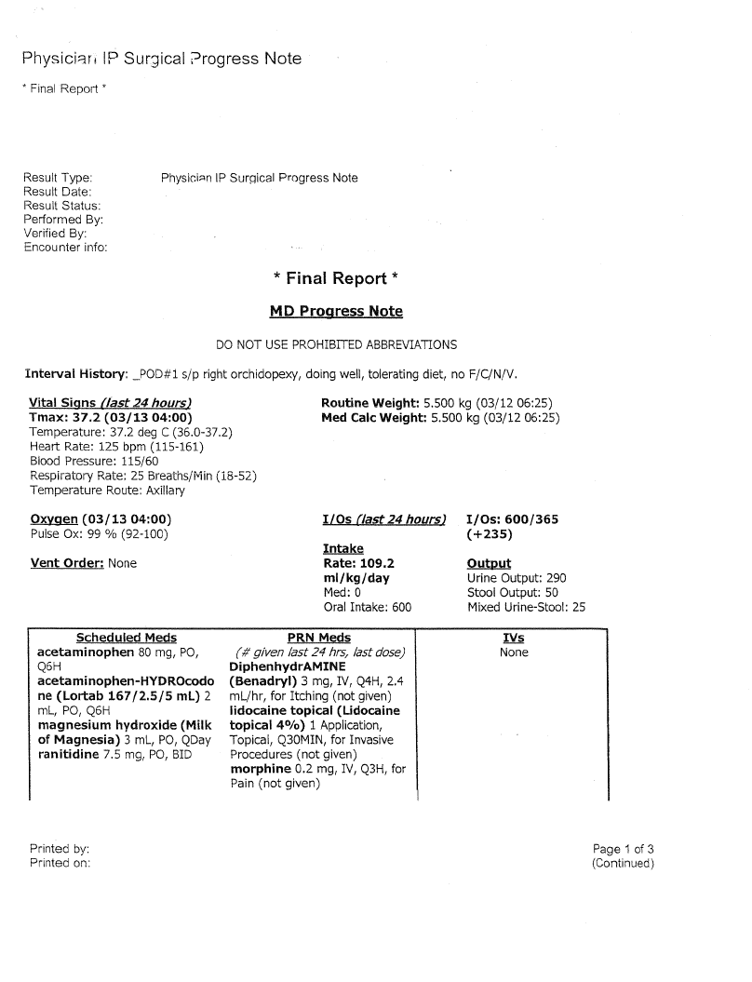

Slide 36
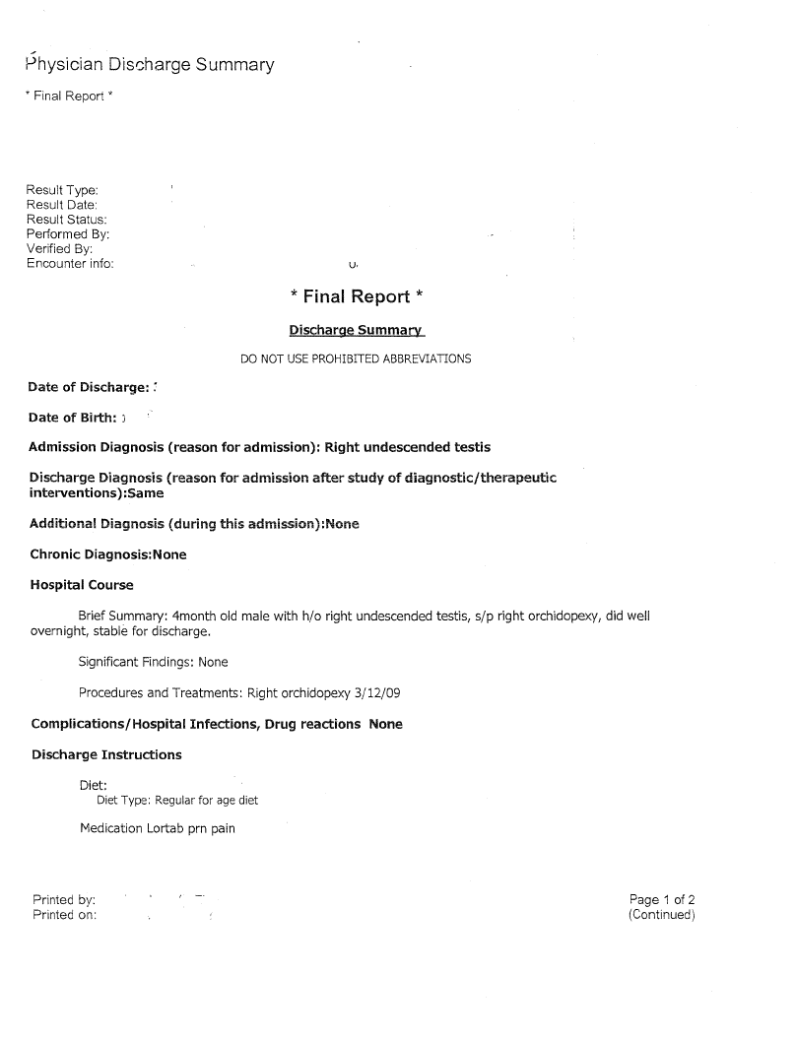

Slide 37
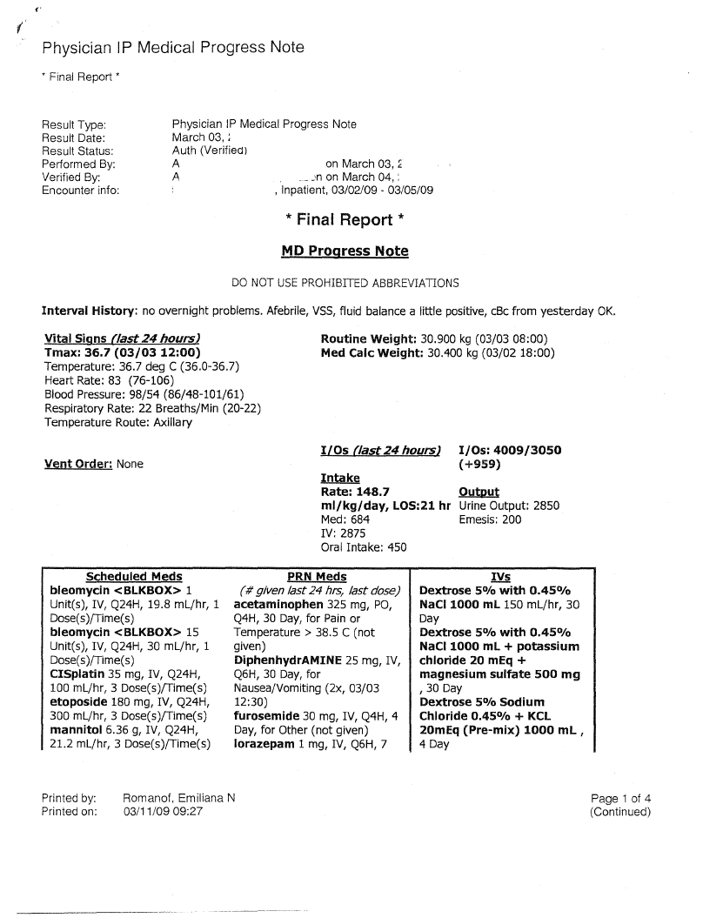

Slide 39
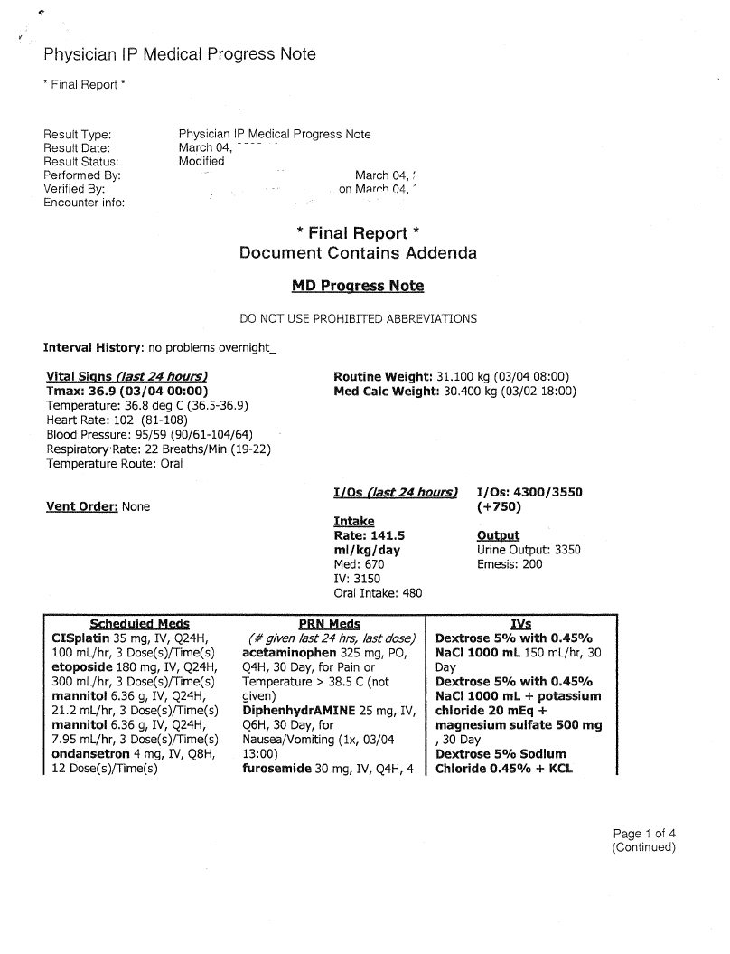

Slide 40
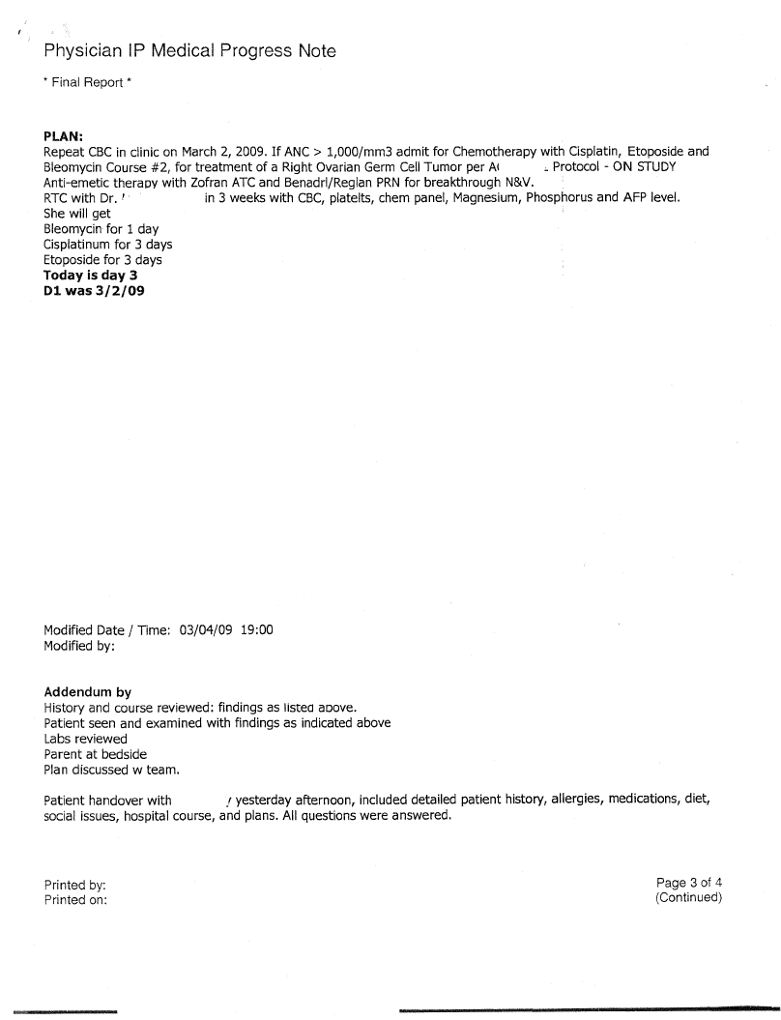

Slide 41
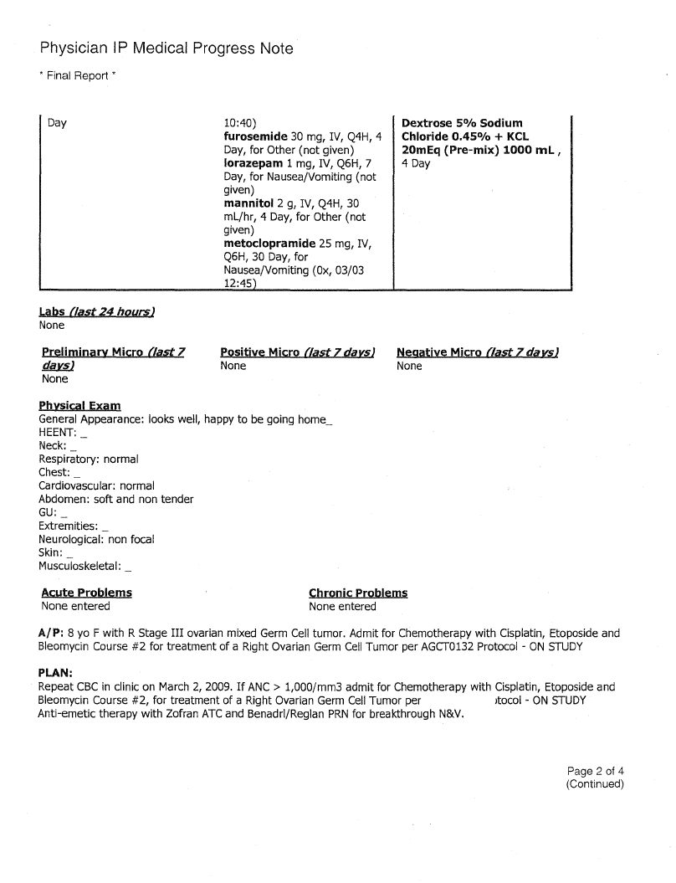
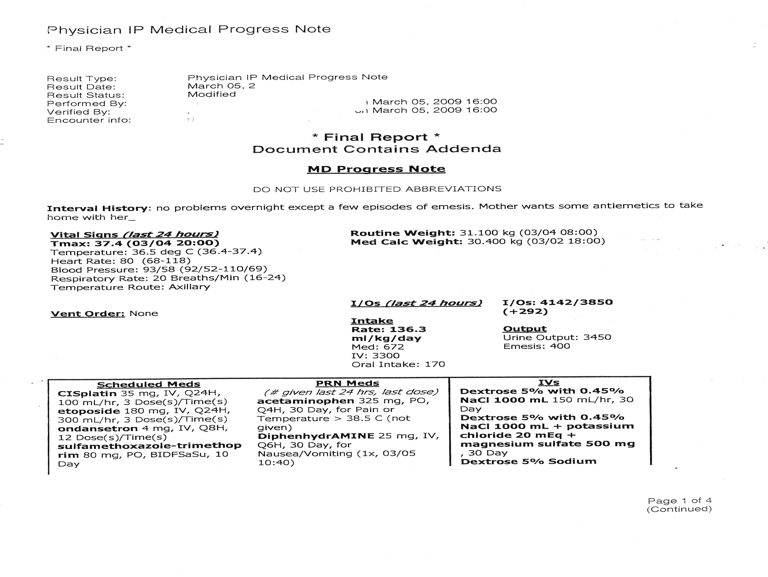

Slide 42
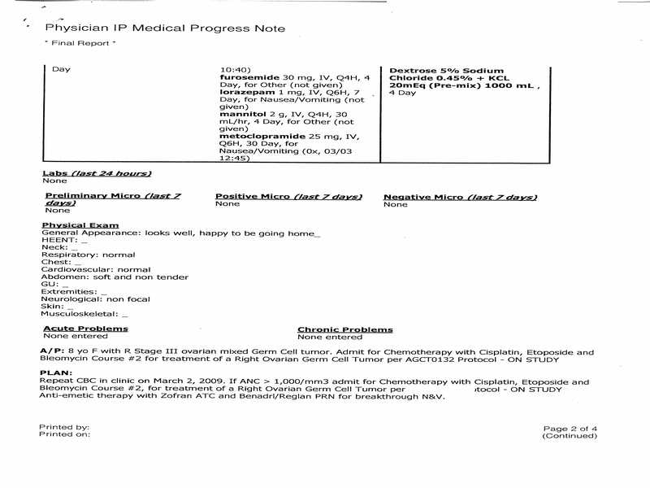

Slide 43
Key Points Regarding Computer Charting
Narratives
Use a narrative rather than a template or pull down menu
Avoid boilerplate charting
Autotext (“The patient complains that…”)
Beware of awkward syntax: “Hospital Day 1: ‘The patient complains that The patient has been transferred here from Hospital X at her request.’”

Slide 44
Key Points Regarding Computer Charting
Cutting and Pasting
In litigation, this function may create the impression that care is mechanical, routine and impersonal
Problem lists never change, despite the availability of new diagnoses or priorities
Daily progress notes become progressively longer
Notes and errors accumulate

Slide 45
Key Points Regarding Computer Charting
Copying and Pasting
Misinformation is carried forward
Notes become recombinant versions of previous notes
Patient who have been hospitalized for weeks can be on Day 4
Last month’s labs take up permanent residence in the daily results
A consultant copies the notes from the requesting physician and requests a consult (from himself)
One time seizure turns into a seizure disorder

Slide 48
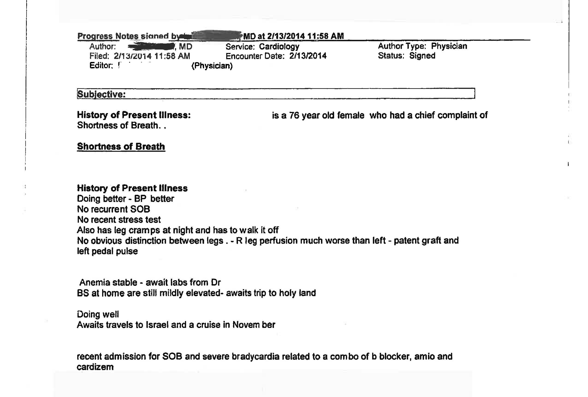

Slide 49
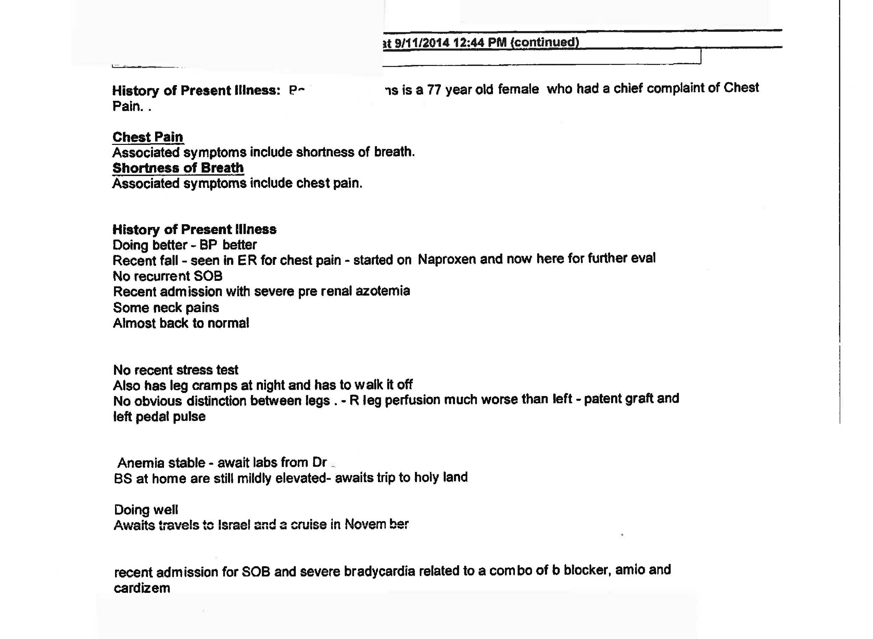

Slide 51
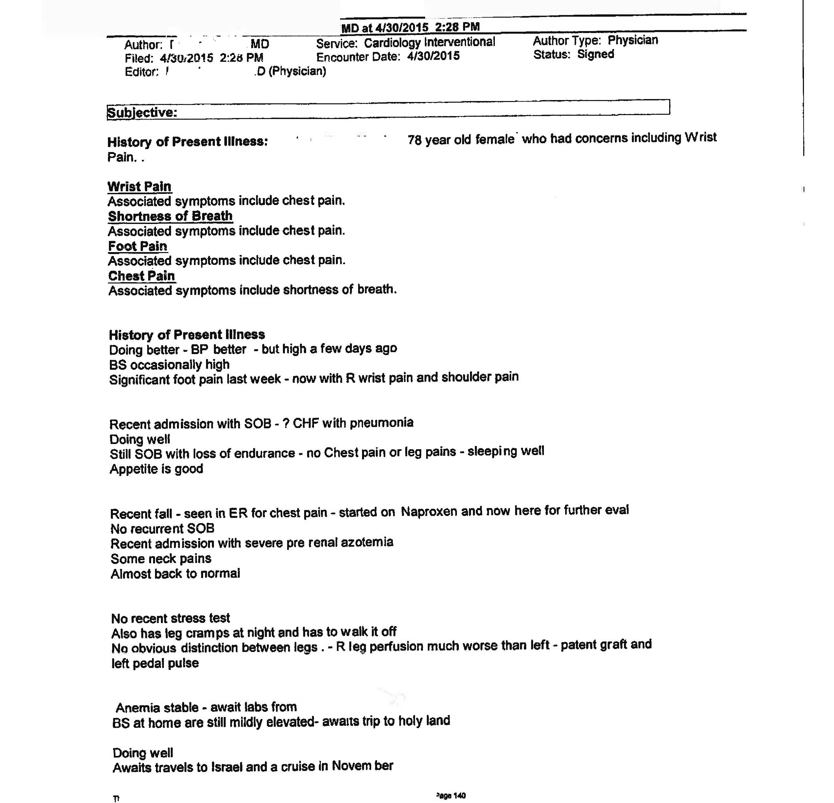

Slide 52
Computer Charting
Know the System
Audit logs can identify everyone who has looked at a patient’s record
Metadata includes information about when a record was created or edited, by whom and how many versions were created.

Slide 53
Reasons for Nursing Liability
Failure to follow Physicians Orders Promptly & Correctly
Failure to Report Questionable Care or Substandard Care
Failure to Monitor the Patient Properly
Failure to Protect the Patient from Avoidable Injury
Failure to Take Complete History

Slide 54
Nursing Liability
Nurses are in closest contact with patient, their families and physician
Conduit of Information
Responsible for their independent judgment
Accountable for their actions and decisions

Slide 55
Areas of Potential NICU Nursing Exposure
Extravasations
Arterial Line Issues
Hypoglycemia
Identification of Changes
Resuscitation
Phone Calls

Slide 56
Areas of Potential NICU Nursing Liability
Medication Errors
Long stays with multiple medications and changed orders
Complexity of Medications
Wrong Medication, Dose, Schedule or Infusion rate (including nutrition)
Error in Administration
Wrong Patient (breast milk)
Errors with lines and tubing (enteral feed into IV; tube misconnections)

Slide 57
Areas of Potential NICU Nursing Liability
Skin Breakdown
Long Stays
Fragile Skin
Tubes and Lines
Sepsis
Long Stays
Patient Conditions

Slide 58
Litigation
$20 Million Settlement (San Diego)
Machine not set properly resulting in excess glucose leading to electrolyte imbalance
$11.5 Million Verdict (Chicago)
Failure to recognize NEC
$12 Million Verdict (Tampa)
Failure to recognize NEC
$7.5 Million Verdict
Failure to recognize NEC
$5 Million (Tufts)
Failure to recognize NEC
$800,000
Failure to recognize Hypoglycemia
$4 Million (Rhode Island)
Failure to recognize Hypoglycemia

Slide 64
Communication
Begins at the door
Knock
Introduce yourself/your role
Why are you there?
White Boards
Listen
Attentive
Posture
Use their name
Empathy
Identify barriers to knowledge
Ask open-ended questions
Avoid medical jargon

Slide 65
Communication
Don’t ask what other healthcare provider said
Pay attention to your nonverbal cues and acknowledge emotions
Be comfortable with silence: give patient 5 seconds to resume conversation when there is a lapse
Watch your body language - don’t appear hurried, bored, fidgety, etc.
End the interaction on a positive note

Slide 66
Rapport
Try to build a partnership
Treat their concerns as important
Explain why you prioritize certain concerns over others
Do not imply their opinions are baseless
Cross-cultural differences
Time expectations
Negotiate?
Try not to show frustration/irritation/intolerance
Have parents write down questions/issues

Slide 67
Document and Follow Up to Concerns
Do not imply Patient complaints are baseless
Threatening to sue
Source of information

Slide 68
Charting on Difficult Patients
What is the problem?
Objective – Material Facts
Cause if known
Plan regarding care of patient
Action Taken
If assistance offered

Slide 69
Don’ts
Chart referral to patient relations
Chart Incident report made
Chart reference to risk management
Comments regarding parents attitude

Slide 70
Questions?

